Slide 1
Section 6.3 Combinations with Pascal’s Triangle
© Copyright all rights reserved to Homework depot: www.BCMath.ca

Slide 2
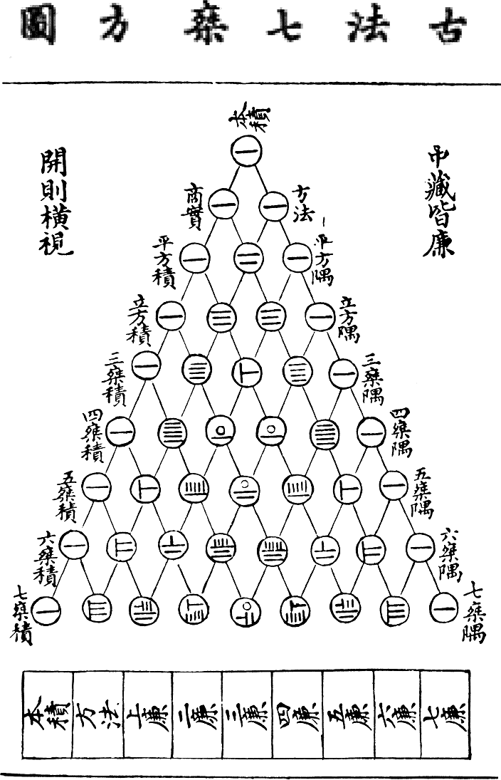
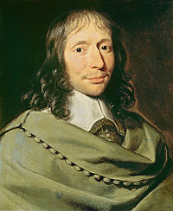
Blaise pascale and Pascal’s triangle
Blaise Pascal (June 19, 1623 – August 19, 1662) was a French mathematician, physicist, and religious philosopher
He used the triangle to solve problems in probability theory.
Numbers used in Pascal’s triangle was discovered by many mathematicians before him but with different applications
The earliest explicit depictions of the triangle occur in the 10th century in commentaries on the Chandas Shastra (India)
In Iran, it is known as "Khayyam triangle” (1048-1131); , finding nth roots of a binomial expansion (section 6.6)
In China, it is known as “Yang Hui's
triangle"(1238-1298)
In Italy, they call it "Tartaglia's triangle", used in
solving cubic polynomials(1500-1577)
© Copyright all rights reserved to Homework depot: www.BCMath.ca

Slide 3
Pascal’s triangle
1
Begin with three 1’s on the top
1
1
Each number is the sum of the
values directly above
1
2
1
1
3
3
1
1
4
6
4
1
1
5
10
10
5
1
1
6
15
20
15
6
1
1
7
21
35
35
21
7
1
1
8
28
56
70
56
28
8
1
1
9
36
84
126
126
84
36
9
1
1
10
45
120
210
252
210
120
45
10
1
© Copyright all rights reserved to Homework depot: www.BCMath.ca

Slide 4
Pascal’s Triangle with Combinatorics
Each row corresponds
with the value of “n”
Begin with n = 0 at
the top
Each diagonal column
corresponds with the
value of “r”, beginning
with r = 0
Note: The n^{th} row will have with have “n+1” columns
Ie: when n=5, there will be 6 diagonal columns
© Copyright all rights reserved to Homework depot: www.BCMath.ca

Slide 5
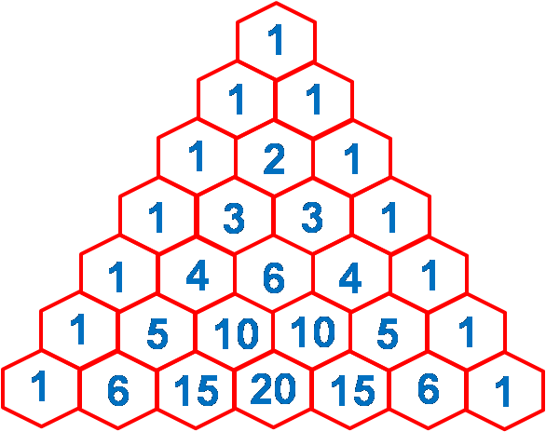
Symmetrical Pattern:
There is a symmetrical pattern in Pascal’s triangle
Opposite sides of the triangle are equal
General formula for
Symmetrical Pattern:
© Copyright all rights reserved to Homework depot: www.BCMath.ca

Slide 6
Recursive Pattern:
Each term is the sum of the two terms directly above
If there is only one term above, then they will be equal
General formula for
Recursive Pattern:
© Copyright all rights reserved to Homework depot: www.BCMath.ca

Slide 7
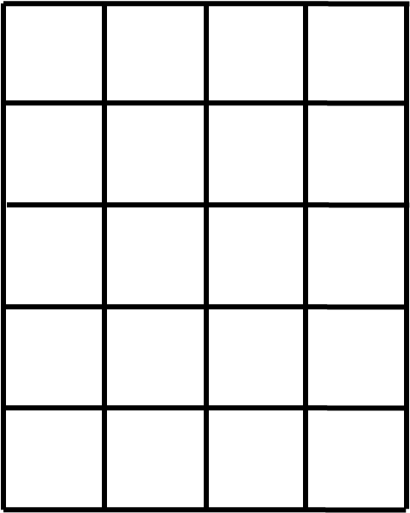
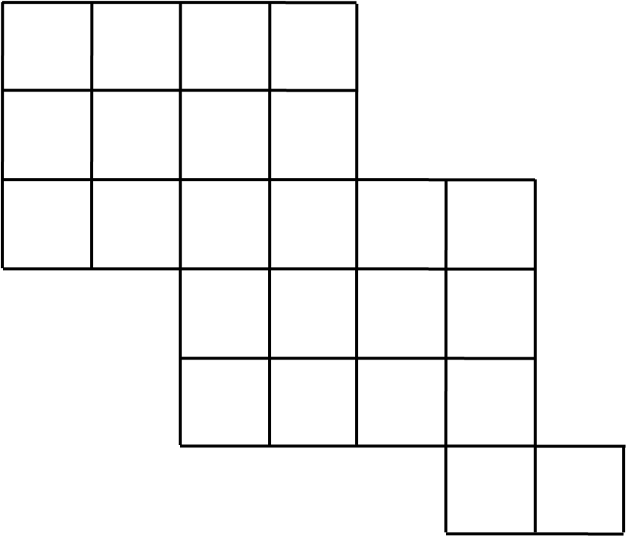
Pathway Problems:
Ex: Using Pascal’s Triangle, find the number of pathways from A to B, if you can only go right or down.
1
1
1
1
A
1
1
1
2
1
A
2
1
3
3
1
1
1
3
4
6
4
1
1
3
1
4
10
10
5
1
6
4
1
1
5
10
10
20
15
10
5
6
10
30
35
15
15
20
15
21
35
40
65
50
15
35
56
105
115
65
70
B
220
180
126
220
400
B
520
400
1020
© Copyright all rights reserved to Homework depot: www.BCMath.ca

Slide 8
Ex: In the game of checkers, you can only go forward by moving diagonally to the left or right. With the following checker, how many ways are there to reach the other side?
The total number of ways to
reach the other side will be:
1
1
1
2
1
1
3
3
1
4
6
4
1
4
10
10
5
14
20
15
5
14
34
35
20
© Copyright all rights reserved to Homework depot: www.BCMath.ca

Slide 9



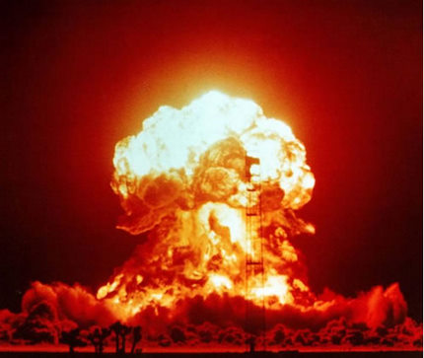

Challenge: Jack can only travel East or South to get to work. Given the following obstacles, how many pathways are there from “A” to “B”?
A
1
1
1
1
1
1
Obstacles:
Flood
1
Accident
1
2
3
4
2
Nuclear Bomb
1
3
6
10
10
11
13
1
4
10
20
11
24
1
5
20
20
31
55
1
6
6
26
46
77
132
294
1
7
13
39
85
162
B
© Copyright all rights reserved to Homework depot: www.BCMath.ca

Slide 10
Challenge: Given the following equation, Solve for “n”
For each row in Pascal’s triangle,
the sum of all the coefficients is
equal 2^{n}
© Copyright all rights reserved to Homework depot: www.BCMath.ca

Slide 11
Which of the following is equal to the expression below?

